Slide 1

DEPARTMENT OF ARTIFICIAL INTELLIGENCE AND DATA SCIENCE
Federated Learning Integration to Build Robust Urban Intelligence for Smart Cities
Team Members
Javvaji Dileep (21761A5415)
Jamili V G S K Rishi Kumar (21761A5414)
Avanigadda Durga Sankar (21761A5404)
Under the Guidance of
Mr. Narendra Babu Pamula,
Sr. Assistant Professor,
Department of AI&DS.

Slide 2
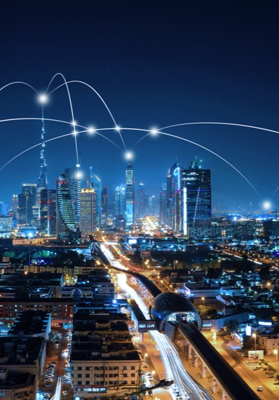
INTRODUCTION
Federated learning is a decentralized machine learning approach that enables multiple entities to collaboratively train models without sharing raw data. Unlike traditional centralized systems, federated learning keeps data local and only exchanges model updates, such as parameters or gradients. This privacy-preserving method is ideal for applications involving sensitive data, including healthcare, finance, and city planning.
In this project, we apply federated learning to address modern urban challenges through three modules:
Air Quality Prediction
Water Quality Monitoring
Weather Prediction

Slide 3

ABSTRACT
This project introduces a federated learning framework to build resilient urban intelligence through privacy-preserving and distributed data analysis. It integrates three key modules: air quality prediction, water quality monitoring, and weather monitoring. The air quality prediction module forecasts the Air Quality Index (AQI) using distributed data, ensuring privacy and accuracy. The water quality monitoring module evaluates critical parameters like pH and turbidity to ensure water safety. The weather monitoring module provides real-time forecasts for disaster preparedness and resource management. By leveraging federated learning, sensitive data remains decentralized and secure, enhancing the accuracy and reliability of predictions.

Slide 4
LITERATURE SURVEY
S.NO | Methodology | Algorithms used | Gaps Identified | Summary
1 | Federated Learning with Iot Sensors, Collaborative Model Training and Aggression | Federated Averaging (FedAvg), Lightweight ML Models | Non-IID Data Distribution Communication Costs | This approach maintains data privacy & achieves challenges with non –IID data.
2 | Federated Learning for Distributed air Quality Monitoring | Federated Averaging(FedAvg), RNN, CNN,LSTM | Communication overhead, Scalability Issues | This paper explores FL combined with Multi Access Edge computing for air quality.
3 | Federated Learning with PSO Optimization | Federated Learning, PSO Optimization | Requires real time application validation & broader geographic scalability | Utilized FL to classify water quality while addressing data privacy issues

Slide 5
LITERATURE SURVEY
S.NO | Methodology | Algorithms used | Gaps Identified | Summary
4 | Utilized IoT-based smart sensors, edge servers, and federated learning to predict water quality | Federated Learning, Scheduling Algorithms | Limited focus on temporal adaptability of models. | Proposed a distributed system for water quality monitoring using FL and IoT sensors for real-time big data analysis.
5 | Hybrid OVMD-DWT pre-processing and adaptive-mLSTM forecasting | OVMD, DWT, Adaptive-mLSTM | High computational requirements, limited generalization | A hybrid decomposing and deep learning approach vastly improved short term weather predictions.
6 | Text mining and reviewing 500 papers on NWP and climate applications | ANN, SVM, PCA, K-means | Limited labeled data, interdisciplinary challenges | Comprehensive review showing how ML techniques improve the accuracy and efficiency of NWP and climate prediction.

Slide 6
PROPOSED WORK

Slide 8
Thank you
Brita Tamm
502-555-0152
brita@firstupconsultants.com
www.firstupconsultants.com

